Slide 1
NETFLIX DATASET ANALYSIS
CAPSTONE PROJECT
Presented By:
Harish. S
2021306017

Slide 2
OUTLINE
Problem Statement
Proposed System/Solution
System Development Approach
Algorithm & Deployment
Result
Conclusion
Future Scope
References

Slide 3
Problem Statement
To develop a comprehensive training model that provides cutting edge data analysis on Netflix TV shows and movies through visualization of different aspects of data provided within the dataset . And credibility to different interrogations of variable interests like Viewership demographics by country, TV shows / Movies with most durations etc.

Slide 4
Proposed Solution
Utilizing advanced machine learning algorithms, our solution will analyze extensive historical Netflix watch hour data on TV shows and movies to establish patterns and correlations.
Solution could be to conduct a comprehensive statistical analysis using techniques such as regression analysis or machine learning algorithms.
• For data , a predictive model will consider factors such as duration , watch hour, provision of user
recommendation based on historical data collected .
.• Additionally, a specialized model will predict watch patterns based on viewer’s preference in genre
of movies/TV shows by manifesting train models that strategically renders the algorithm to
recommend appropriate suggestions in the home page.
This holistic approach aims to empower subscribers and members alike with actionable
intelligence for strategic decision-making in a dynamic landscape.

Slide 5
System Approach
Building the proposed solution would involve a combination of data processing, feature engineering, and machine learning. Here are the key system and library requirements:
System Requirements:
Hardware:- A computer with sufficient processing power, preferably with multiple cores or a GPU for faster training of machine learning models.- Adequate RAM to handle the size of the dataset and computational requirements.
Software: An operating system compatible with the required machine learning libraries (e.g., Windows, Linux, macOS).

Slide 6
System Approach
Library Requirements:
Data Processing and Analysis:-
Pandas: For data manipulation and analysis.-
NumPy: For numerical operations on data.
Data Visualization:-
Matplotlib and Seaborn: For creating visualizations to understand data patterns.
Plotly or Bokeh: Interactive visualization libraries for more complex visualizations.edunet

Slide 7
Algorithm & Deployment
Algorithm Selection
Data Exploration:
• Explore the NETFLIX dataset's structure, features, and target variable(s).
• Identify potential patterns, correlations, and outliers.
Problem Formulation:
• Define the problem : Predict fundamental aspects that are valuable for data analysis like ideal duration of movie/ tv show, relevancy of data and likelihood that the viewer might prefer it to be recommended based on historical data.
Algorithm Selection :
Regression tasks (e.g, predicting daily traffic):• Consider linear regression, decision trees, or ensemble methods (XGBoost, LightGBM).• Classification tasks (e.g, predicting special request):• Consider logistic regression, decision trees, or random forests.

Slide 8
Algorithm & Deployment
Data Input
Data Collection:
• Gather historical user/viewer data, including information on choice of preference (ex: genre of movie), length of movie/TV show, special requests, user profiles, and relevant details.
Data Cleaning:
• Handle missing values, outliers, and any inconsistencies in the dataset.
• Convert categorical variables into numerical representations through encoding techniques.
Feature Engineering:
• Create new features or modify existing ones based on domain knowledge.
• Extract meaningful information from date variables that are chronologically precise.

Slide 9
Algorithm & Deployment
Training Process
Data Splitting:
• Divide the dataset into training and testing sets to evaluate the model's performance.
Feature Sealing:
• Standardize or normalize numerical features to ensure they have a consistent scale.
Model Training:
• Use the selected algorithm to train the model on the training dataset.
• Adjust hyperparameters to optimize model performance.
Model Evaluation:
• Evaluate the model on the testing dataset using appropriate metrics (e.g., Mean Squared Error for regression, accuracy, precision, recall for classification).
• Fine-tune the model if necessary..

Slide 10
Algorithm & Deployment
Prediction Process
New Data Input:
• Collect new data or use existing data to make predictions.
Preprocessing:
• Apply the same data preprocessing steps (cleaning, feature engineering, scaling) to the new data.
Model Inference:
• Use the trained model to make predictions on the new data.
Results Interpretation:
• Interpret the model's predictions in the context of the problem at hand.
• For regression, interpret the predicted values as optimal rates or lengths of stay. For classification, interpret predictions as the likelihood of special requests.

Slide 11
Algorithm & Deployment
DEPLOYMENT
Deploy the trained model in a suitable environment, such as a web application or API, where it can be used to make predictions on new data.
When deploying the model, it's important to consider factors like scalability, latency, veracity and security. Additionally, regular monitoring and updates may be necessary to ensure the model continues to perform well as new data becomes available or as the underlying factors change over time.

Slide 12
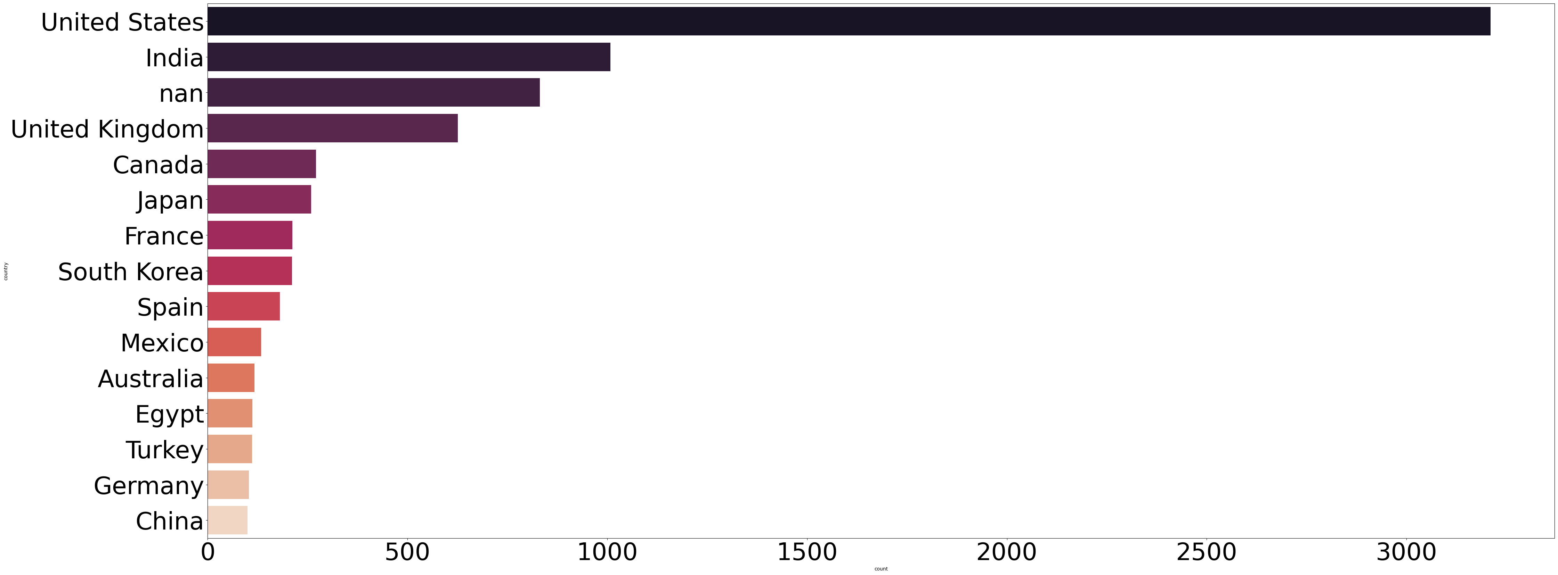
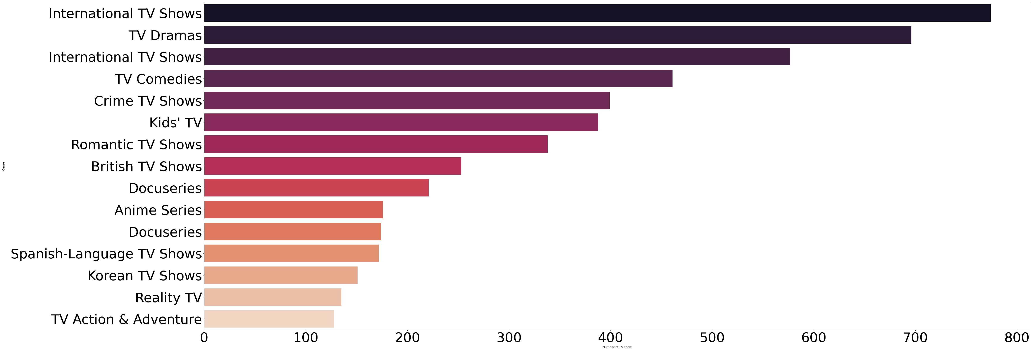
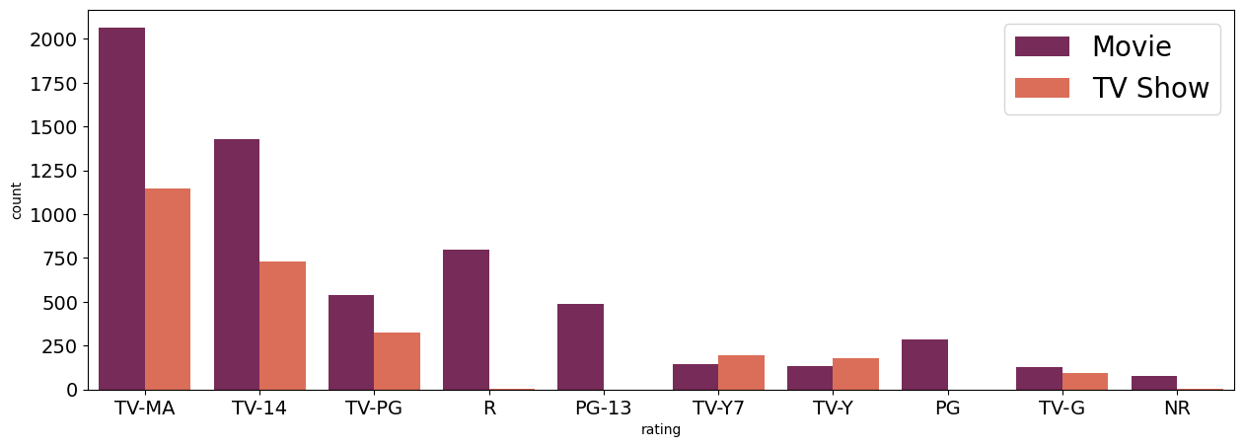
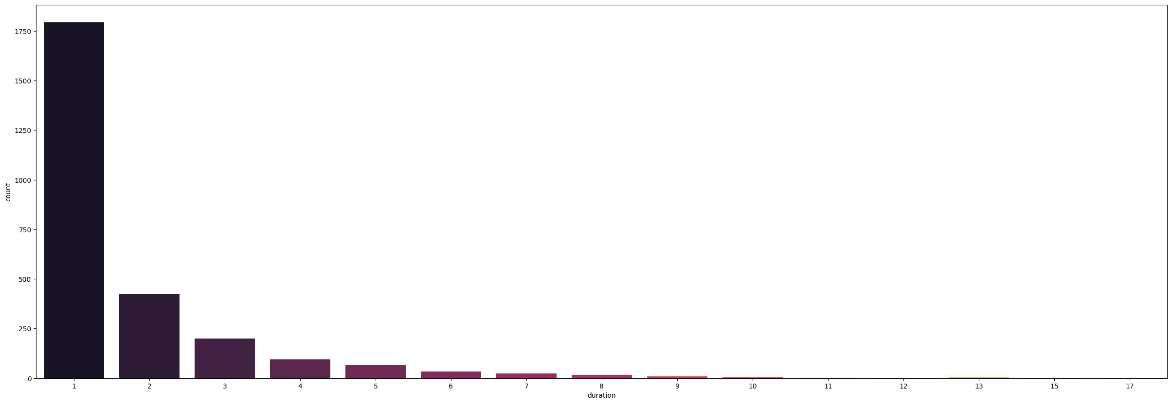
RESULT

Slide 13
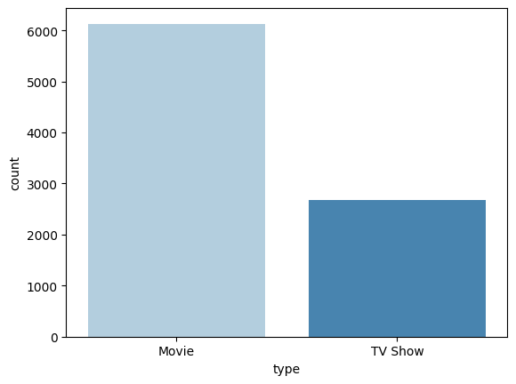
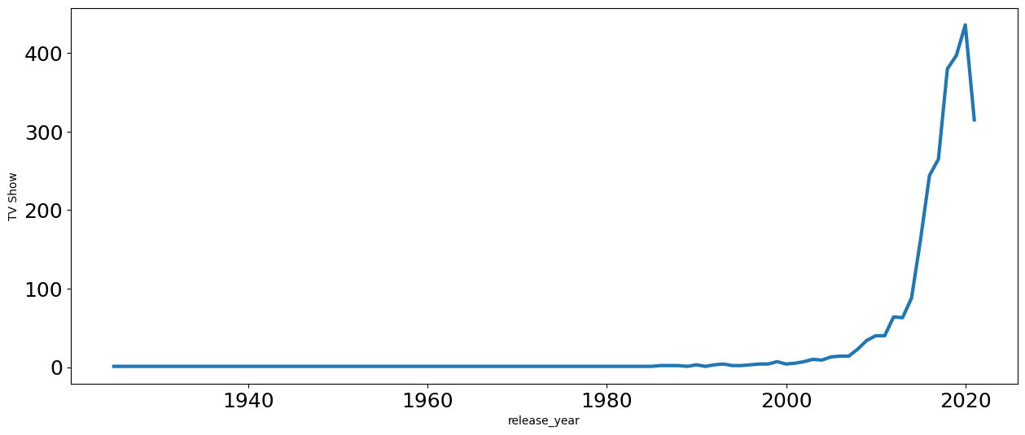
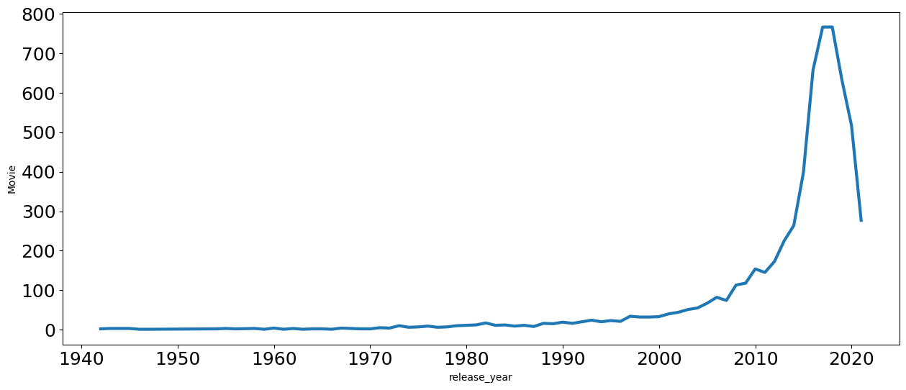
RESULT

Slide 14
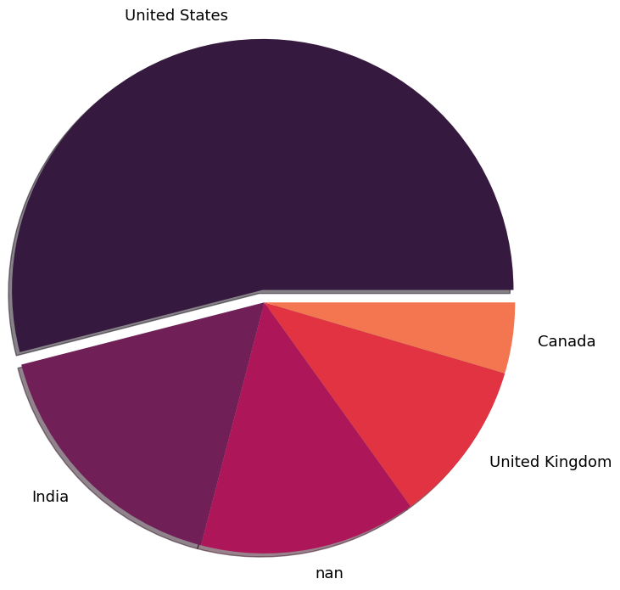
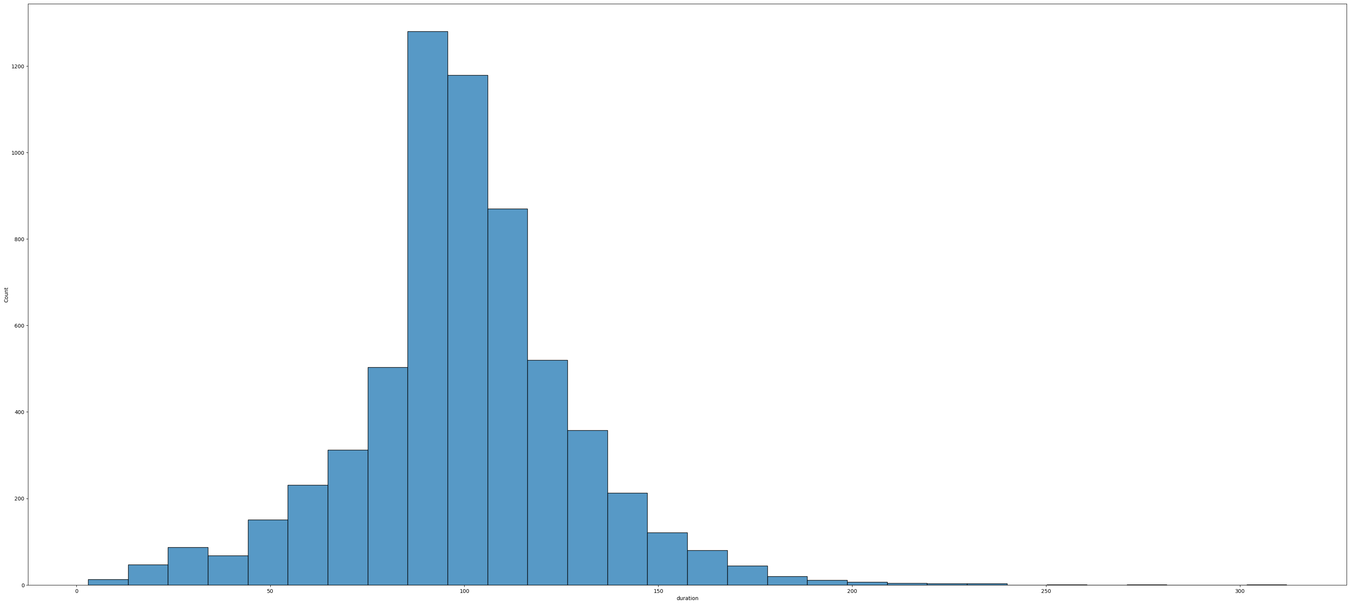
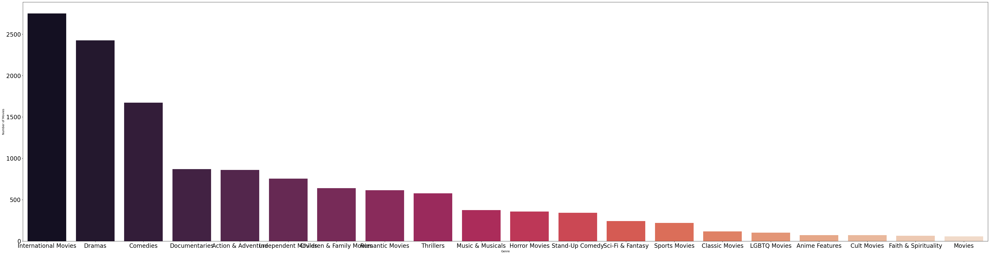
RESULT

Slide 15
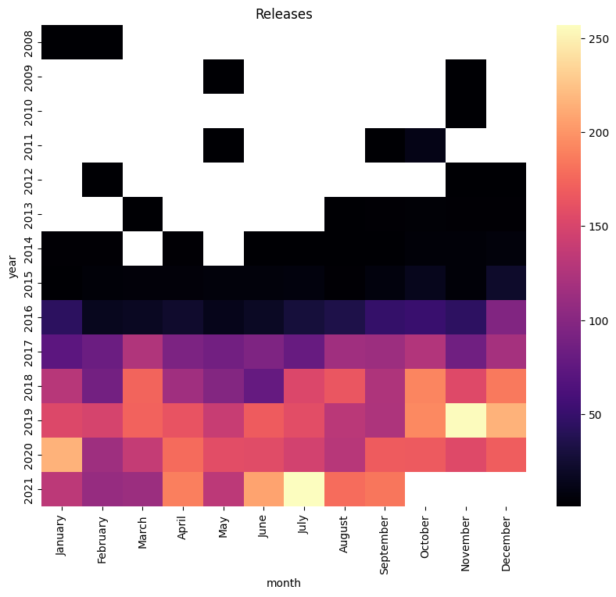
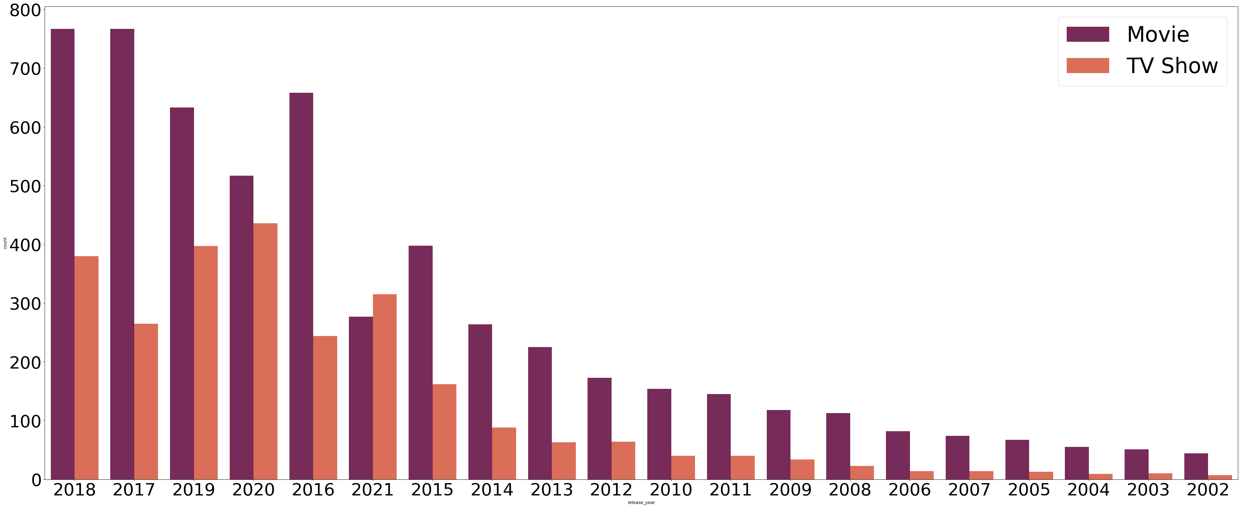
RESULT

Slide 16
Conclusion
In Conclusion, our proposed solution harnesses the power of advanced machine learning algorithms and train models to utilize and implement Historical Netflix user dataset in performing data analysis . It is evident from the analysis that various factors play pivotal role in influencing the outcome like diversity in genre , languages in which movies are made that are at the disposal of the user’s preference. And the data analysis clearly justifies the underlying reason behind why international movies and tv shows draws more attention among the sample space. Also trying to understand big data that are of fruitful interests to organizations like that of Netflix is enunciated by allowing data science to produce valuable data in the form of visualizations and graphical representation. This enhances and encourages companies to understand their stakeholders better and work towards providing cutting edge user recommendation and suggestions.

Slide 17
Future scope
By Leveraging Data of historical significance and pattern analysis using machine learning algorithms , streaming platforms like Netflix can develop predicting models capable of performing valuable data analysis by the use of Artificial general intelligence (AGI).
Real-time Predictions:
• Move towards real-time predictive models that are accountable for adapting to instantaneous fluctuations in data volatility, external events , and other dynamic factors to provide users with up-to-the-minute insights about their services.
Personalization and Customization:
• Enhance the predictive models to offer more personalized recommendations by considering individual user preferences, platform history, and user-specific requirements, providing a tailored and customizable experience for everyone.

Slide 18
References
https://www.kaggle.com/datasets
https://pandas.pvdata.org/pandas-docs/stable/user guide/index.html
https://seaborn.pydata.org/
https://matplotlib.org/stable/contents.html

Slide 19
THANK YOU

